Slide 1
Random Forest
© Templateswise.com
By: Ninja Stars
Group members: Myamin Abushokan, Wed Aljuaid, Ibtisam Alshammari, Mohammed Alomyri, Mohammed Mostanteq

Slide 2
Agenda:
Introduction.
What is a Random Forest?
How to Create a Random Forest?
Classification vs Regression.
Random Forest Applications.
Advantages and Disadvantages.

Slide 3
Introduction
Random Forests are the better version of decision trees. They combine the simplicity of decision trees with flexibility resulting in extreme improvement in accuracy.

Slide 4
What is a Random Forest?
A Random forest is a classification algorithm consisting of many decision trees. It uses bagging and features randomness when building each individual tree to try to create an uncorrelated forest of trees whose prediction by committee is more accurate than that of any individual tree.

Slide 5
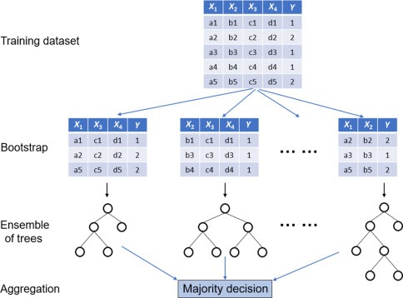
Here is an Example of a Random Forest

Slide 6
How to Create a Random Forest ?
Create a bootstrapped dataset by picking random samples from the original dataset.
Create a decision tree using bootstrapped dataset, but only use a random subset of variables (or columns) at each step.
When creating a bootstrapped dataset, we’re allowed to pick the same sample more than once.
Root node of the tree will randomly select columns from bootstrapped.

Slide 7
How to Create a Random Forest ? Con.
4. Pick random columns to be child of nodes.
5. Continue until you get a big decision tree.
6. Repeat steps above to get a good amount of decision trees (forest).
Using bootstrapped sample and considering only a subset of the variables at each step results in a wide variety of trees, and that what makes random forests more effective than individual decision trees.

Slide 8
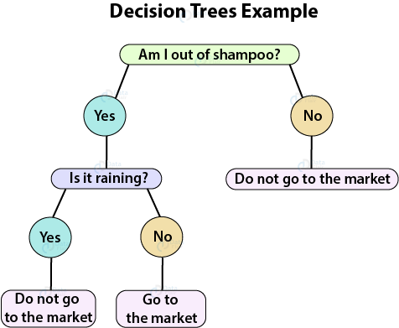
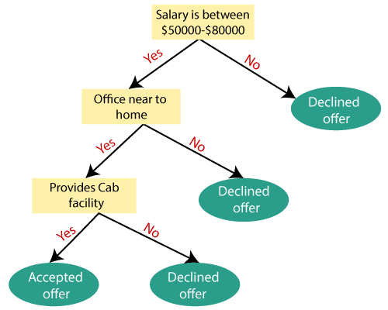
How Decision Trees Look Like?

Slide 9
How to Create a Random Forest ? Con.
To make a decision, run your data down to all trees and keep track of all the results.
The decision is the result that received the most votes or the result that was mostly repeated.
Bagging: Bootstrapping the data plus using the aggregate to make a decision
Since we’re randomly selecting data and allowed repetition, usually almost ⅓ of the original data won’t be included in the bootstrapped data

Slide 10
How to Create a Random Forest ? Con.
The data that wasn’t included is called Out-Of-Bag Dataset
You still can run the Out-Of-Bag-Dataset and see if it correctly classifies the sample
Run it through all the trees
The proportion of Out-Of-Bag samples that were correctly classified by the random forest measures how accurate our random forest is.
However, If it was incorrectly classified then it’s Out-Of-Bag-Error
Rebuild the trees based on more variables per step.
Test a punch of different settings until reaching the most accurate random forest.

Slide 11
Classification Vs. Regression
Classification: is simply the process of taking some kind of input, supposing x, and mapping it to some discrete labels.
These discrete labels or better known as class.
Example: A patient is suffering from cancer or not, a person is eligible for a loan or not, etc. It’s either True or False, no other options.
Regression: is more about continuous value function.
they cannot be defined by classes.
Example- predicting the price of houses, t-shirts produced in a factory, etc. The output here is a number.

Slide 12
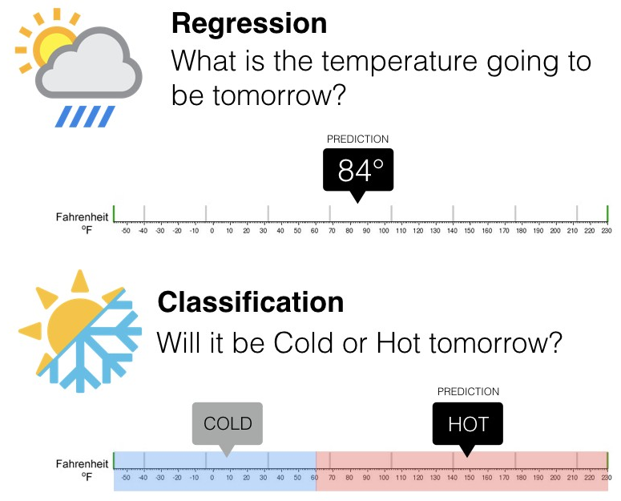

Slide 13
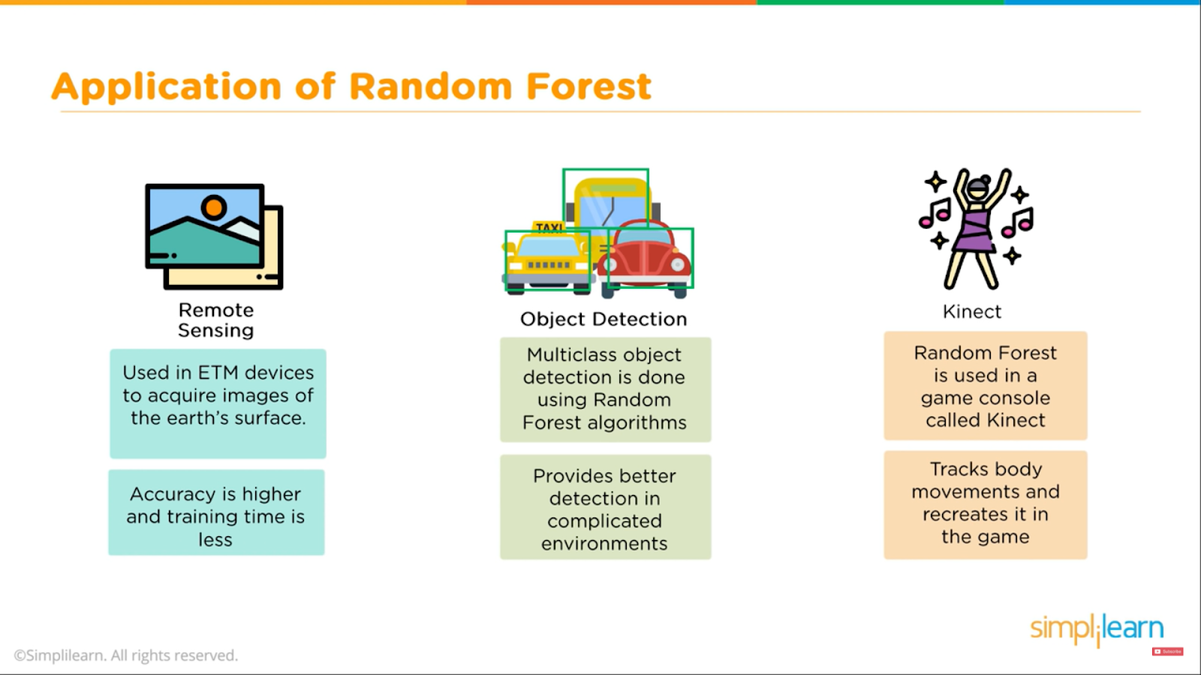

Slide 14
Banking Industry
Credit Card Fraud Detection
Customer Segmentation
Predicting Loan Defaults on LendingClub.com
Healthcare and Medicine
Cardiovascular Disease Prediction
Diabetes Prediction
Breast Cancer Prediction
Stock Market
Stock Market Prediction
Stock Market Sentiment Analysis
Bitcoin Price Detection
E-Commerce
Product Recommendation
Price Optimization
Search Ranking

Slide 15
Advantages Vs. Disadvantages
Advantages:
Random forests can be used for both classification and the regression tasks
It can handle the missing values and maintains accuracy for missing data.
The data usually won’t overfit the model
It handles large datasets with higher dimensionality

Slide 16
Advantages Vs. Disadvantages Cont.
Disadvantages:
They do a good job at classification but not as good as for regression as it doesn’t give a precise continuous nature prediction.
In the case of regression, it doesn’t give a prediction that is beyond the range of the train data. They may overfit the train data, so they are particularly noisy.
You have a little control on what the model does.

Slide 17
Questions?

